Slide 1
AWS Greengrass Demo

Slide 2
Agenda
Introduction
Components
Setting up AWS Greengrass
Demo

Slide 3
Introduction
AWS Greengrass is a service offered by Amazon Web Services (AWS) that extends AWS capabilities to edge devices, allowing them to run AWS Lambda functions, synchronize data with AWS, and communicate securely with other devices even when they are not connected to the cloud.
Greengrass is designed for use cases where you need to perform edge computing, real-time data processing, and IoT (Internet of Things) device management.

Slide 4
Components
AWS Greengrass Core
AWS Lambda
Device Gateway
Local Shadow Service
Local Resource Access
Connectors

Slide 5
Setting up AWS Greengrass
Setting up Greengrass involves the following steps:
1. Create a Greengrass Group: You define a Greengrass Group in the AWS Management Console, which represents a collection of devices that run Greengrass Core. You specify the AWS Lambda functions and resources that should be deployed to the group.
2. Define Group Configuration: Configure the group to define which Lambda functions run locally, message routing rules, and other settings.
3. Download and Install Greengrass Core: You install the Greengrass Core software on your edge devices and associate them with the Greengrass group.
4. Deployment: Deploy the group configuration and Lambda functions to the Greengrass Core devices.
5. Manage and Monitor: You can monitor the status of your Greengrass Core devices and update configurations as needed

Slide 6
Demo
Overview: In this demo, we'll set up an AWS IoT Greengrass environment, connect to an AWS EC2 instance, install Greengrass Version 2 (GGv2), and create and deploy MQTT components. We'll also explore shadow devices and perform LED control using AWS IoT Greengrass on the EC2 instance. Prerequisites:
1. AWS Account: You need an AWS account with sufficient permissions to create IAM users, EC2 instances, and AWS IoT Greengrass resources.
2. AWS EC2 Instance: Launch an EC2 instance and connect to it using SSH.
3. AWS CLI: Install and configure the AWS CLI on your EC2 instance.
4. AWS IoT Greengrass Group: Create an AWS IoT Greengrass Group in your AWS account.

Slide 7
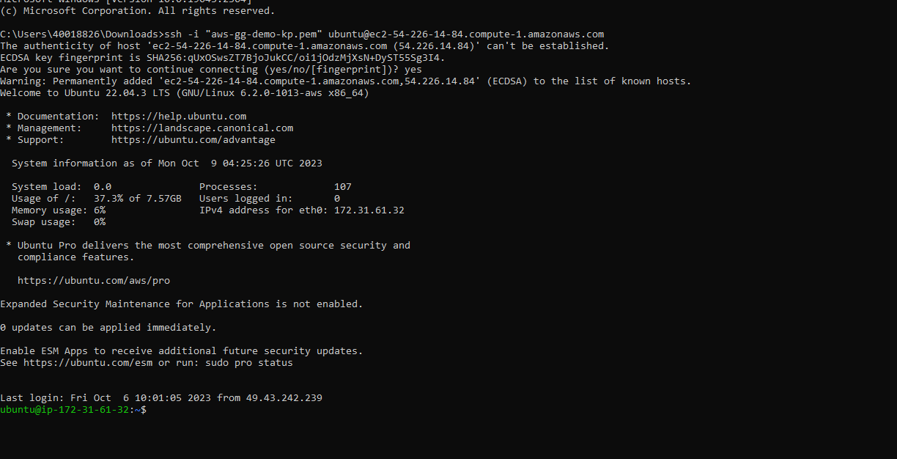
Demo
Steps:
Step 1: Connect to the EC2 Instance

Slide 8
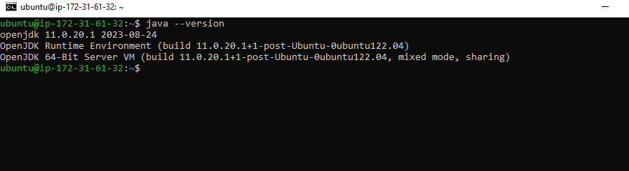
Demo
Steps:
Step 2: Create IAM User to Provision Device and obtain the credentials
Step 3: Install Java on the EC2 Instance
Install Java on the machine based on the operating system
Check the installation status

Slide 9
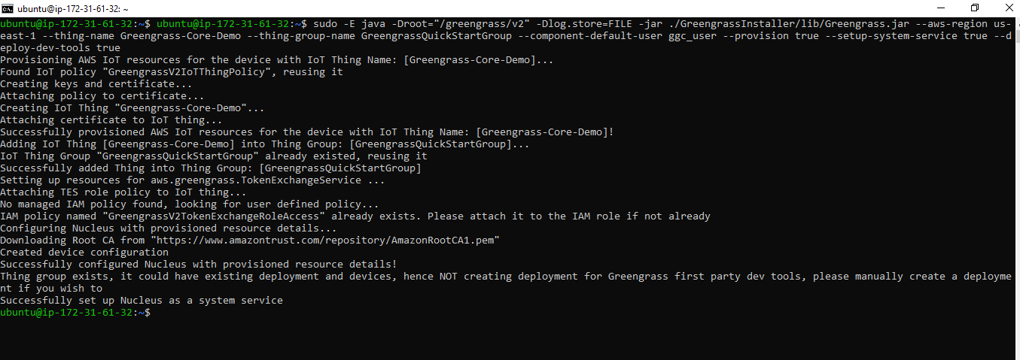
Demo
Steps:
Step 4: Install and run GGv2 on the EC2 Instance
Provide the access key ID and secret access key for your IAM user in the EC2
In AWS IoT Greengrass service select setup one core device and update the necessary details
Using the commands provided there, download and run GGv2 on the EC2 based on the operating system

Slide 10
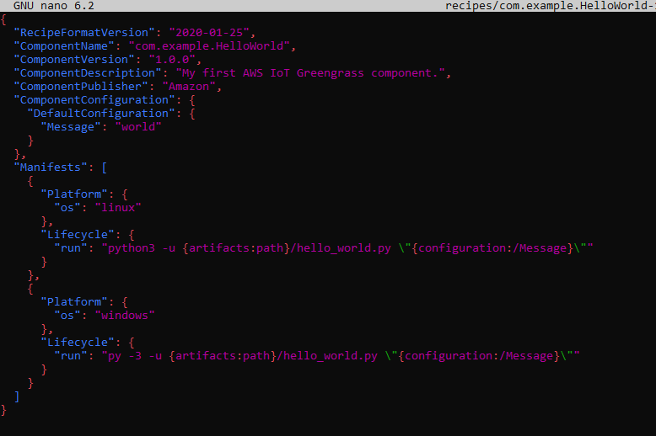
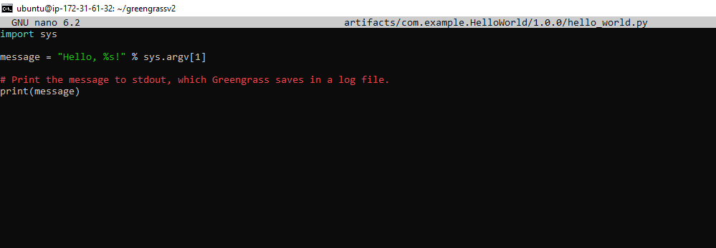
Demo
Step 5: Disable IAM User for security
Step 6: Deploy New Component to GG on EC2

Slide 11
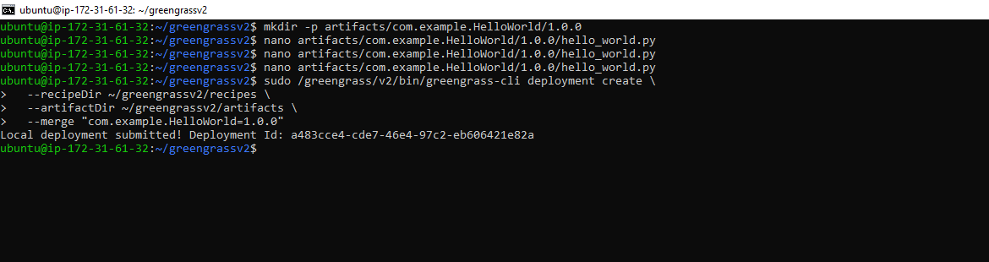
Demo
Demo

Slide 12
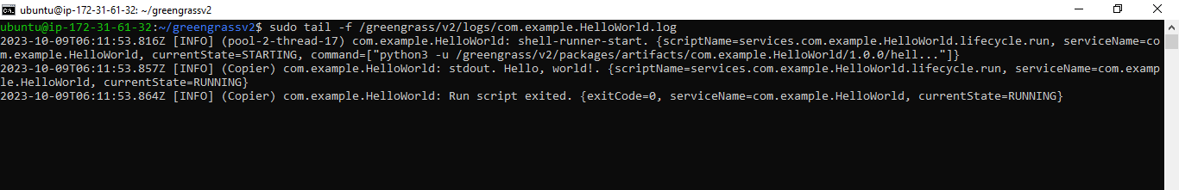
Demo
Demo
7: Check Deployment on EC2 Instance

Slide 13
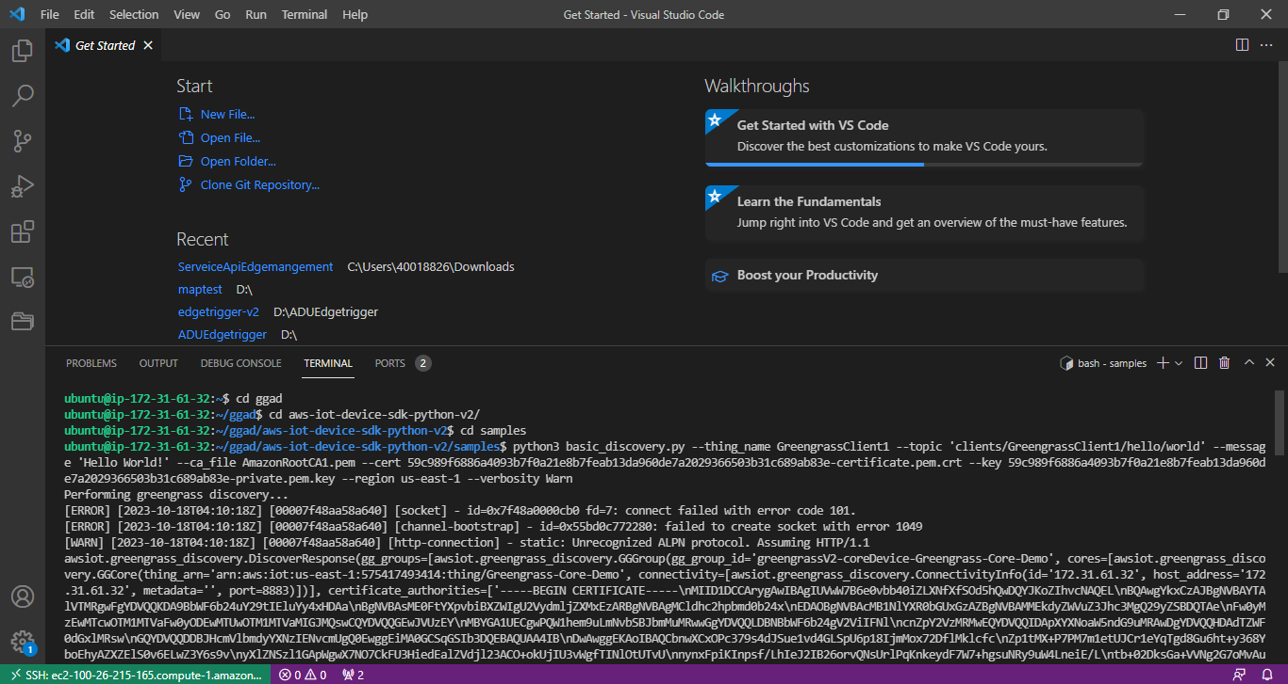
Demo
Demo
Follows these steps for remote access of the EC2 (if needed)
Step 8: Install VSCode and Remote SSH Extension
Step 9: VSCode Remote Port Forwarding

Slide 14
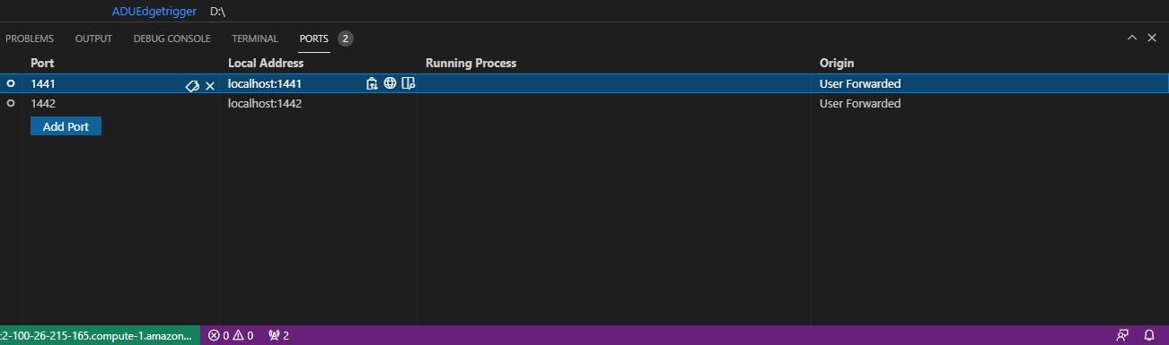
Demo
Demo

Slide 15
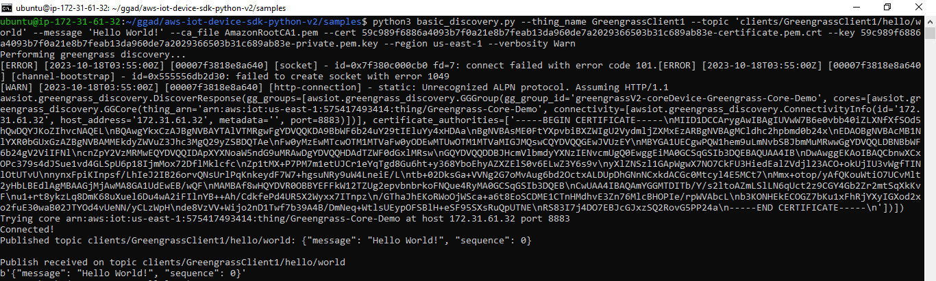
Demo
Demo
Step 12: Update Greengrass Policy Document
Step 11: Create and Deploy MQTT Component
Step 12: Test Component

Slide 16
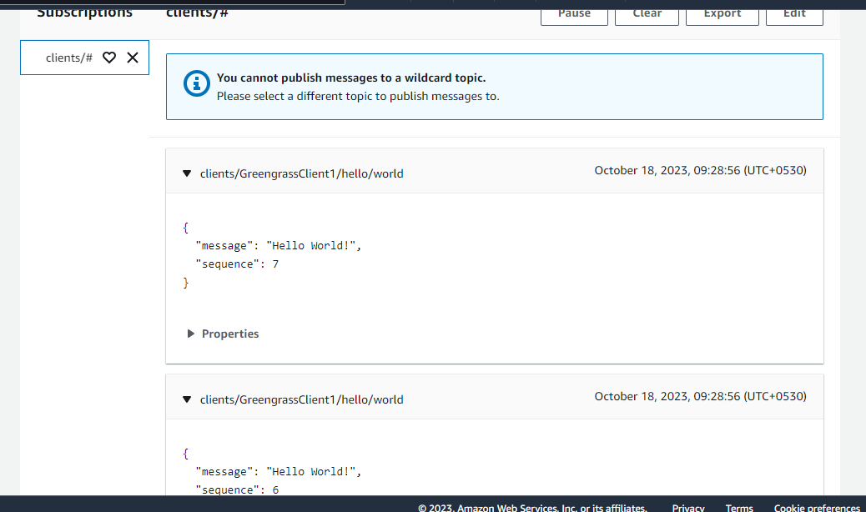
Demo
Demo

Slide 17
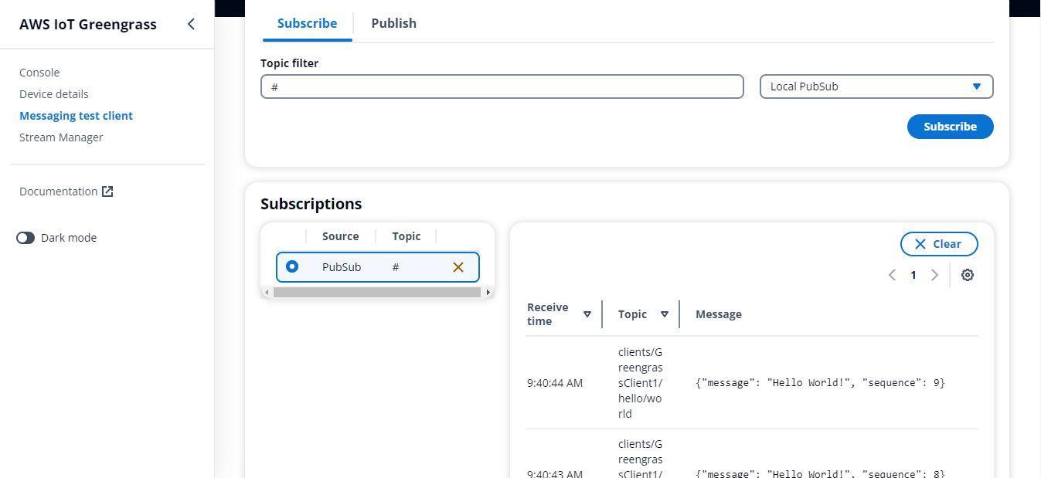
Demo
Demo

Slide 18
THANK YOU

